Slide 1
SMART STICK
AJAY .K
HARISH .R
JEEVA .A.M

Slide 2
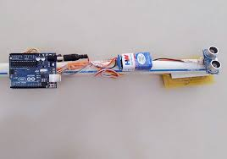
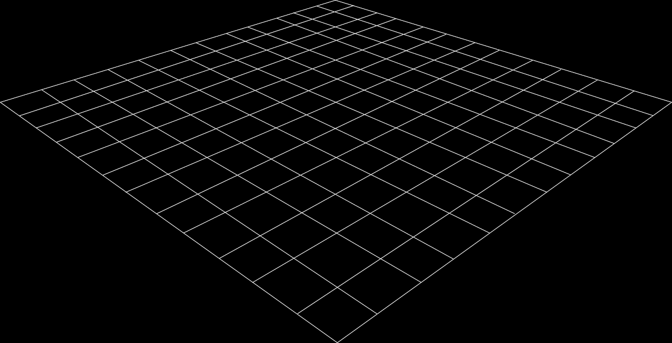
OBJECTIVE
Blind stick is an innovative stick designed for visually disabled people for improved navigation. We here propose an advanced blind stick that allows visually challenged people to navigate with ease using advanced technology. The blind stick is integrated with ultrasonic sensor along with motors. Our proposed project first uses ultrasonic sensors to detect obstacles ahead using ultrasonic waves. On sensing obstacles the sensor passes this data to the microcontroller. The microcontroller then processes this data and calculates if the obstacle is close enough. If the obstacle is not that close the circuit does nothing. If the obstacle is close the microcontroller sends a signal to start the motor to indicate some obstacle is near to the person. At the same time the buzzer will activate along with speaker module.

Slide 3
BLOCK DIAGRAM
Power Supply
Arduino
Nano
APR9600 Module
Speaker
Ultrasonic Sensor
Vibration Motor
Buzzer

Slide 4
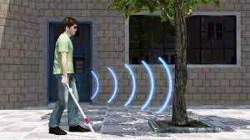
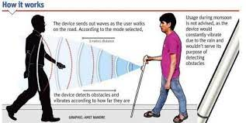
APPLICATIONS
Blind peoples
Deaf peoples
Old aged person
Patients

Slide 5
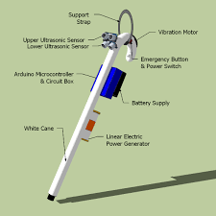
EXISTING METHOD
The existing system consists of the devices or the supports like white cane for helping them to detect the obstacles and travel to places, pet dogs, and smart devices like vision a torch for blinds. But, there were many limitations and problems in this existing systems like in the white cane, it may easily break or crack. The white cane may get stuck at the pavement cracks of the different objects.
Drawbacks
White cane, it may easily break or crack. The white cane may get stuck at the pavement cracks of the different objects.
Whereas the pet dogs cost is huge and need a lot of training

Slide 6
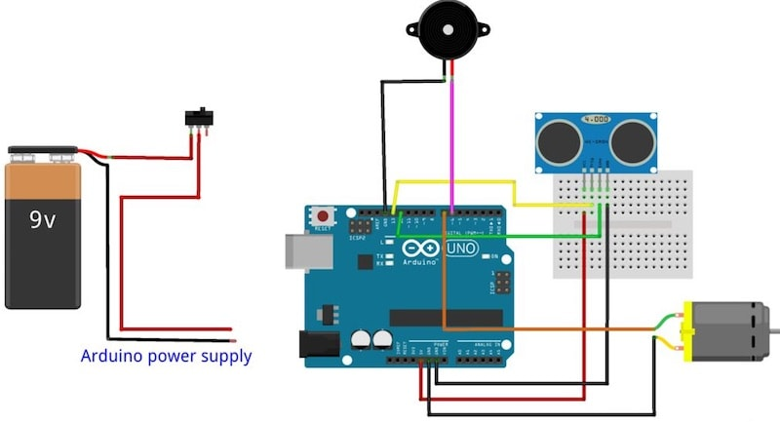
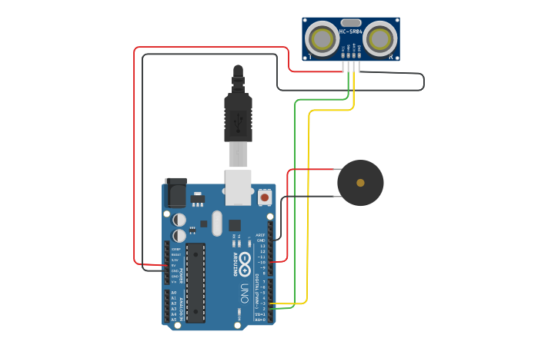
PROPOSED SYSTEM
The working behind this blind stick is that it is used for special purpose as a sensing device for the blind people. It is used widely to detect objects using Ultrasonic sensor. If any object is present, the ultrasonic sensor detects the object by measuring the distance between the object and the user and sends the data to the Arduino. To determine the distance of an object, calculate the distance between sending the signal and receiving back the signal.

Slide 7
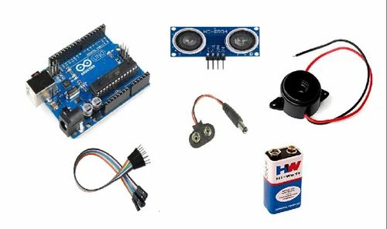
HARDWARE COMPONENTS
Ardunio
Buzzer
Ultrasonic sensor
APR9600 Module
Vibrator motor
Buzzer
Speaker

Slide 8
IMPLEMENTATION
Take Arduino Nano, Buzzer, Ultrasonic sensor, Vibrating motor, battery, switch, and a wooden stick or plastic pipe.
Take stick and place ultrasonic sensor on it. Connect the Jumper wires on it.
Then place Buzzer and Vibrating motor on the stick.
Connect the jumper wires to buzzer and Vibrating motor.
Do connections from circuit diagram.
Place the Arduino Nano, Battery and switch on the stick.
Upload the code
After Uploading now check for the Blind stick.

Slide 9
CONCLUSION
The stick presented here is making the life of visually impaired people much easier than before. It makes them independent and also mobile. Moreover its cost effectiveness would never be a hindrance to them in purchasing this device. With this the visually impaired person will be more mobile and hence independent

Slide 10
THANK YOU

